Slide 1
Lecture 9 Balanced Search Trees
Jianchen Shan
Department of Computer Science
Hofstra University

Slide 2
Lecture Goals
Develop balanced search trees with guaranteed logarithmic performance for search and insert (and many other operations).
We begin with 2-3 trees, which are easy to analyze but hard to implement.
Next, we consider red-black binary search trees, which we view as a novel way to implement 2-3 trees as binary search trees.
Finally, we introduce B-trees, a generalization of 2-3 trees that are widely used to implement file systems.

Slide 3

2−3 Search Trees
The 2-3 tree is a way to generalize BSTs to provide the flexibility that we need to guarantee fast performance
Allow 1 or 2 keys per node
2-node: one key, two children.
3-node: two keys, three children.
Perfect balance: Every path from root to null link has same length.
how to maintain?
Symmetric order: Inorder traversal yields keys in ascending order.
So the search is a generalization of the search in BSTs
Search
Compare search key against keys in node.
Find interval containing search key.
Follow associated link (recursively).
3-node
M
2-node
smaller than E
E J
R
larger than J
Search for H
H is less than M (go left)
Search hit
A C
H
L
P
S X
H is between E and J (go middle)
Search for B
B is less than M (go left)
Search miss
between E and J
null link
B is less than E (go left)
B is between A and C (go middle)
Link is null
3

Slide 4
Insert in 2−3 Search Trees
Insertion into a 2-node at bottom.
Search for key, as usual
Add new key to 2-node to create a 3-node.
Insert K
K is less than M (go left)
K is larger than J (go right)
K is less than L
M
Search ends here and replace 2-node with 3-node containing K
R X
E J
R
Insert Z
Z is larger than M (go right)
A C
K L
Z is larger than R (go right)
H
L
P
S X
S Z
S X Z
S
Z
Z is larger than X
Search ends here
Replace 3-node with temporary 4-node containing Z
Split 4-node into two 2-nodes (pass middle key to parent)
Insertion into a 3-node at bottom.
Add new key to 3-node to create temporary 4-node.
Move middle key in 4-node into parent.

Slide 5
Insert in 2−3 Search Trees (Contd.)
Insertion into a 3-node at bottom.
Add new key to 3-node to create temporary 4-node.
Move middle key in 4-node into parent.
Repeat up the tree, as necessary.
If you reach the root and it's a 4-node, split it into three 2-nodes.
Insert L
L is between E and R (go middle)
Search ends here
Replace 3-node with temporary 4-node containing L
E R
Split 4-node (move L to parent)
H L P
S X
A C
H P
Height of tree increases by 1
L
Split 4-node (move L to parent)
E R
E L R
E
R
A C
H
P
S X
A C
H
P
S X

Slide 6
2−3 Search Trees Construction
Insert S
Create 2-node in the empty tree
Insert H
Convert 3-node into 4-node
Insert E
Convert 2-node into 3-node
Split 4-node into two 2-nodes (move R to parent)
Insert A
Convert 3-node into 4-node
Insert X
Convert 2-node into 3-node
Split 4-node into two 2-nodes (move E to parent)
Insert P
Convert 2-node into 3-node
Insert R
Convert 2-node into 3-node
Insert L
Convert 3-node into 4-node
Insert C
Convert 2-node into 3-node
Split 4-node into two 2-nodes (move R to parent)
Split 4-node into two 2-nodes (move R to parent)
E L R
E R
L
E S
A E S
S
A C
H P
S X
E
R
A
H L P
S
H P
H
A C
H
P
S X
E R
E
E L R
E R
A C
H R S
H S
R S
A
S
Create a new root node. And then the height of the tree grows by one. And that's a legal 2-3 tree, so we stop.
A C
H
P
S X
A
S

Slide 7
Local Transformations in a 2-3 Tree
Converting a 2-node to a 3-node
Converting a three to a four, and then splitting and passing a node up
a e
b c d
only operations we need to consider to get balance.
local transformation: constant number of operations.
less than a
between
a and b
between
b and c
between
c and d
between
d and e
greater than e
Only involves changing a constant number of links, and is independent of the tree size.
a c e
b
d
less than a
between
a and b
between
b and c
between
c and d
between
d and e
greater than e

Slide 8








Global Properties in a 2-3 Tree
Invariants. Maintains symmetric order and perfect balance.
Proof. Each transformation maintains symmetric order and perfect balance.
Splitting a 4-node
root
parent is a 3-node
a b c
b
left
d e
b d e
a
c
a b c
a
c
parent is a 2-node
middle
a e
a c e
left
d
b d
b c d
b
d
a b c
a
c
right
a b
a b d
right
a
a c
c d e
c
e
b c d
b
d
The height doesn’t change. If it is perfect balance before, it is perfect balance afterwards

Slide 9











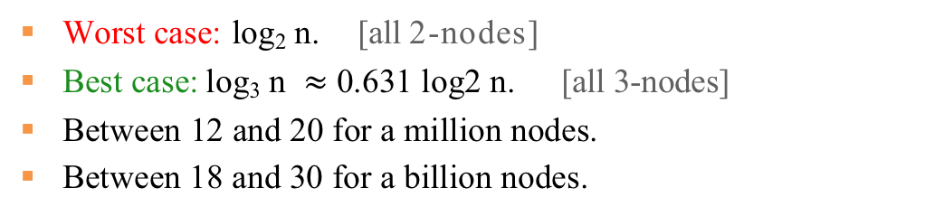
Performance of 2-3 Tree
Perfect balance: Every path from root to null link has same length.
So, that's going to give us, a very easy way to describe a performance.
Operations have costs that's proportional to the path link from root to the bottom.
Tree height
 | Best case | Average case | Worst case
BST | O(1) | O(log n) | O(n)
2-3 Tree | O(1) | O(log n) | O(log n)
Worst case: log₂ n. [all 2-nodes]
Best case: log₃ n $≈$ 0.631 log2 n. [all 3-nodes]
Between 12 and 20 for a million nodes.
Between 18 and 30 for a billion nodes.
2-3 tree model guaranteed logarithmic performance for search and insert.

Slide 10
Lecture Goals
Develop balanced search trees with guaranteed logarithmic performance for search and insert (and many other operations).
We begin with 2-3 trees, which are easy to analyze but hard to implement.
Next, we consider red-black binary search trees, which we view as a novel way to implement 2-3 trees as binary search trees.
Finally, we introduce B-trees, a generalization of 2-3 trees that are widely used to implement file systems.

Slide 11

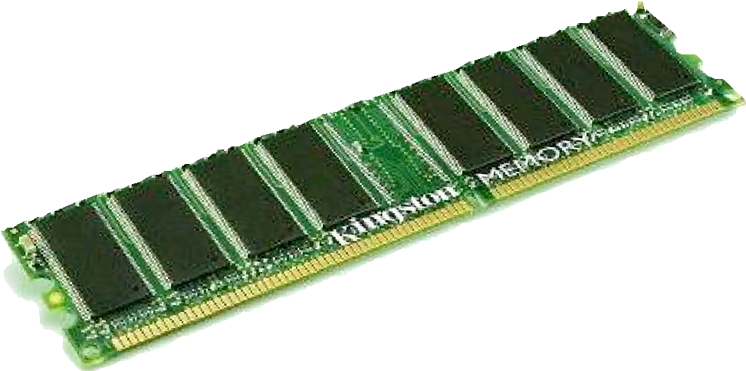
Motivation for B-tree: File system model
Page. Contiguous block of data (e.g., a file or 4,096-byte chunk). Probe. First access to a page (e.g., from disk to memory).
slow
fast
Property. Time required for a probe is much larger than time to access data within a page.
Cost model. Number of probes.
Goal. Access data using minimum number of probes.

Slide 12
B-trees (Bayer-McCreight, 1972)
Generalize 2-3 trees by allowing up to M - 1 key-link pairs per node.
At least 2 key-link pairs at root.
At least M / 2 key-link pairs in other nodes.
External nodes contain client keys.
Internal nodes contain copies of keys to guide search.
Choose M as large as possible so that M links fit in a page, e.g., M = 1024
2-node
K
sentinel key
internal 3-node
each red key is a copy of min key in subtree
D
H
K
Q
U
external 3-node
external 5-node (full)
external 4-node
Q R T U W X Y
B C
D E F
H I J
K M N O P
client keys (black) are in external nodes
all nodes except the root are 3-, 4- or 5-nodes
Anatomy of a B-tree set (M = 6)

Slide 13

Searching in a B-tree
Start at root.
Find interval for search key and take corresponding link.
Search terminates in external node.
searching for E
K
follow this link because
E is between * and K
D
H
K
Q
U
follow this link because
E is between D and H
B C D
E
F
H I J
K M N O P
Q R T
U W X
search for E in this external node
Searching in a B-tree set (M = 6)

Slide 14
Insertion in a B-tree
Search for new key.
Insert at bottom.
Split nodes with M key-link pairs on the way up the tree.
inserting A
H K Q U
B C E F
H I J
K M N O P
Q R T
U W X
H K Q U
A B C E F H I J
K M N O P
Q R T
U W X
new key (A) causes overflow and split
C
H
K
Q
U
new key (C) causes overflow and split
A B
C E F
H I J
K M N O P
Q R T
U W X
K
C
H
root split causes a new root to be created
K
Q
U
A B
C E F
H I J K M N O P
Q R T
U W X
Inserting a new key into a B-tree set

Slide 15
Balance in B-tree
Proposition. A search or an insertion in a B-tree of order M with N keys requires between log _{M-1} N and log _{M/2} N probes.
Pf. All internal nodes (besides root) have between M / 2 and M - 1 links.
In practice. Number of probes is at most 4.
M = 1024; N = 62 billion log M/2 N ≤ 4
Optimization. Always keep root page in memory.

Slide 16
Balanced Trees in the Wild
Red–black trees are widely used as system symbol tables.
Java: java.util.TreeMap, java.util.TreeSet.
C++ STL: map, multimap, multiset.
Linux kernel: completely fair scheduler, linux/rbtree.h.
Emacs: conservative stack scanning.
B-tree variants. B+ tree, B*tree, B# tree, …
B-trees (and variants) are widely used for file systems and databases.
Windows: NTFS.
Mac: HFS, HFS+.
Linux: ReiserFS, XFS, Ext3FS, JFS, BTRFS.
Databases: ORACLE, DB2, INGRES, SQL, PostgreSQL.

